Slide 1
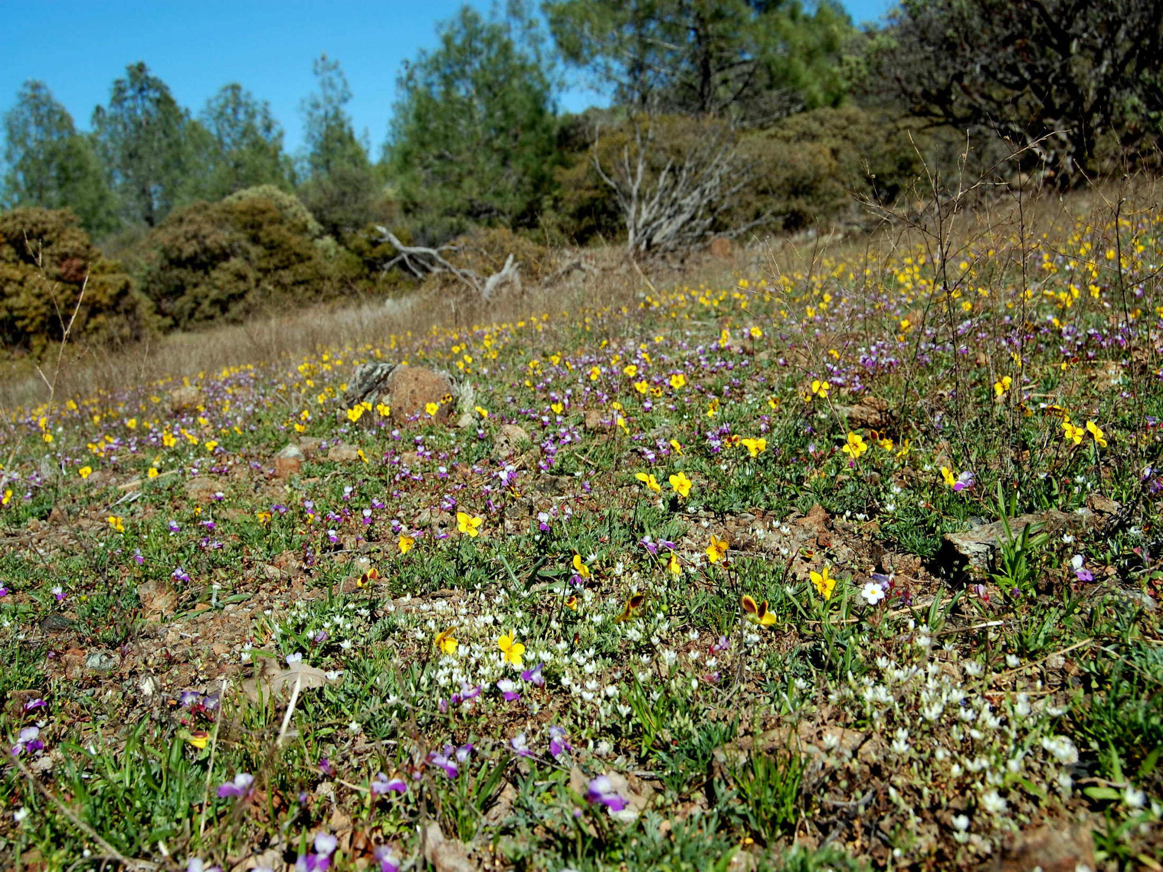
Temporal stability in California grasslands
Barbara Going
Brian Anacker
Susan Harrison
Department of Environmental Science and Policy
University of California, Davis

Slide 2
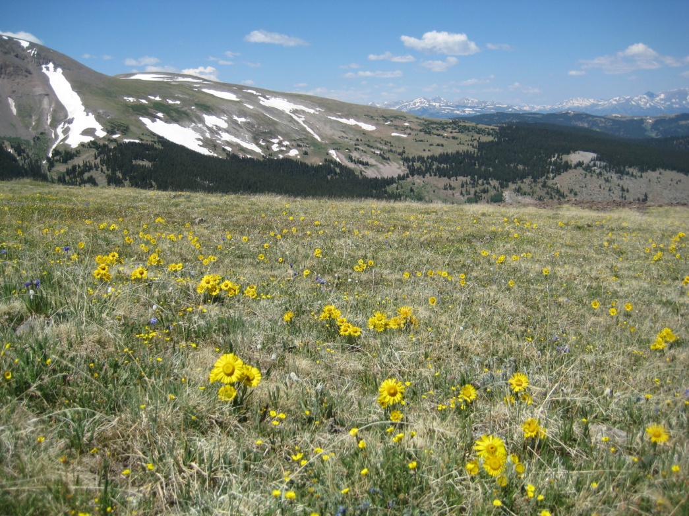
Climate change and plant communities
Climate change alters plant communities
Competition, pollination, diversity
Communities may vary in their response to climate
Topography, substrate, species functional traits
Photo credit: M. Spasojevic
Notes:
There is now more than ample evidence that climate change is having a strong, measurable effect on plant communities. The mechanisms for how climate change alters communities varied and often involve complex interactions between factors like competition, diversity and even pollination.
We also know, somewhat anecdotally, that not all communities seem to respond as strongly or even in the same way; suggesting that there might fundamental differences in the susceptibility of communities to climate change. Some of these difference might be extrinsic factors like topography or substrate, or they might be factors involving the community members themselves, functional traits for example. The list of factors is likely much longer than this, but this talk will only focus on substrate and species traits as possible factors influencing how communities respond to climate change.

Slide 3
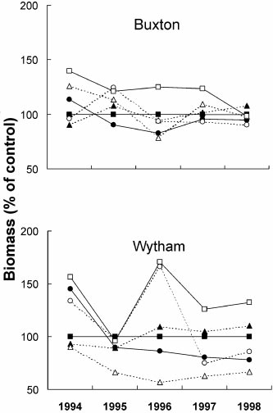
Climate change and plant communities
Ancient, unproductive
Communities on resource-poor soils may be more stable:
Grime et al (2000, 2008): infertile limestone grasslands more stable
Suttle et al (2005): large compositional changes in a coastal grassland
What about special soil communities?
Old field, fertile
Grime et al. 2000
Notes:
While not widely studied, there is experimental evidence that communities vary in their response to climate. First, Grime and colleagues showed quite nicely that communities growing on rather unproductive limestone soils were more stable with respect to productivity than communities growing on more fertile limestone soils nearby. Grime, himself, suggested that species functional traits might be important for how the communities responded. Although not a productive/unproductive soil comparison, Suttle et al showed that five years of water addition to a coastal grassland resulted in very large compositional changes. In fact, the system flipped from being abundant in annual forbs to being almost completely dominated by European annual grasses.
Evidence like this suggests that substrate potentially plays a large role in how communities respond to climate change and that communities living on unique substrates, which are often abiotically challenging for plants, might behave differently than communities growing on relatively benign “normal” soils. This is a bit concerned since species soil communities are major contributors to regional and global biodiversity. In this talk I’m going to talk about a study in which we compared temporal variability in serpentine and non-serpentine grasslands.

Slide 4
California grasslands
Serpentine
Low nutrient availability
High Mg (low Ca:Mg)
Dominance by annual forbs
Non-serpentine
Relatively fertile
Highly invaded
Dominance by exotic annual grasses
 | Serpentine |  | Non-serpentine
Functional group | Mean #/m² | Mean % cover | Mean #/m² | Mean % cover
Annual forb | 9.2 | 35.3 | 7.3 | 29.4
Annual grass | 3.2 | 32.9 | 3.4 | 64.7
Perennial forb | 2.0 | 5.1 | 1.5 | 2.3
Perennial grass | 1.2 | 8.8 | 1.0 | 4.3
Notes:
Serpentine and non-serpentine grasslands differ in ways that could be important for how these communities respond to climate change. First, serpentine soils are low in nutrient availability, especially nitrogen, phosphorus, potassium, and calcium. They also have higher concentrations of magnesium than non-serpentine soil, which results in a low Ca:Mg ratio that often characterizes serpentine. It’s possibly that species in this communities have trait associated to stress tolerance. Non-serpentine soils are relatively more fertile and benign. Functional group diversity and abundance also varies by soil type. Annual forbs tend to dominate serpentine grasslands, both in species richness and in cover. These grasslands also have a fairly good representation of perennial forbs and grasses. Non-serpentine grasslands, in contrast, are dominated by a handful of annual grasses, which are really a pretty novel functional group in California. Very few in this group are actually native. I’ll come back to why that might matter later.

Slide 5
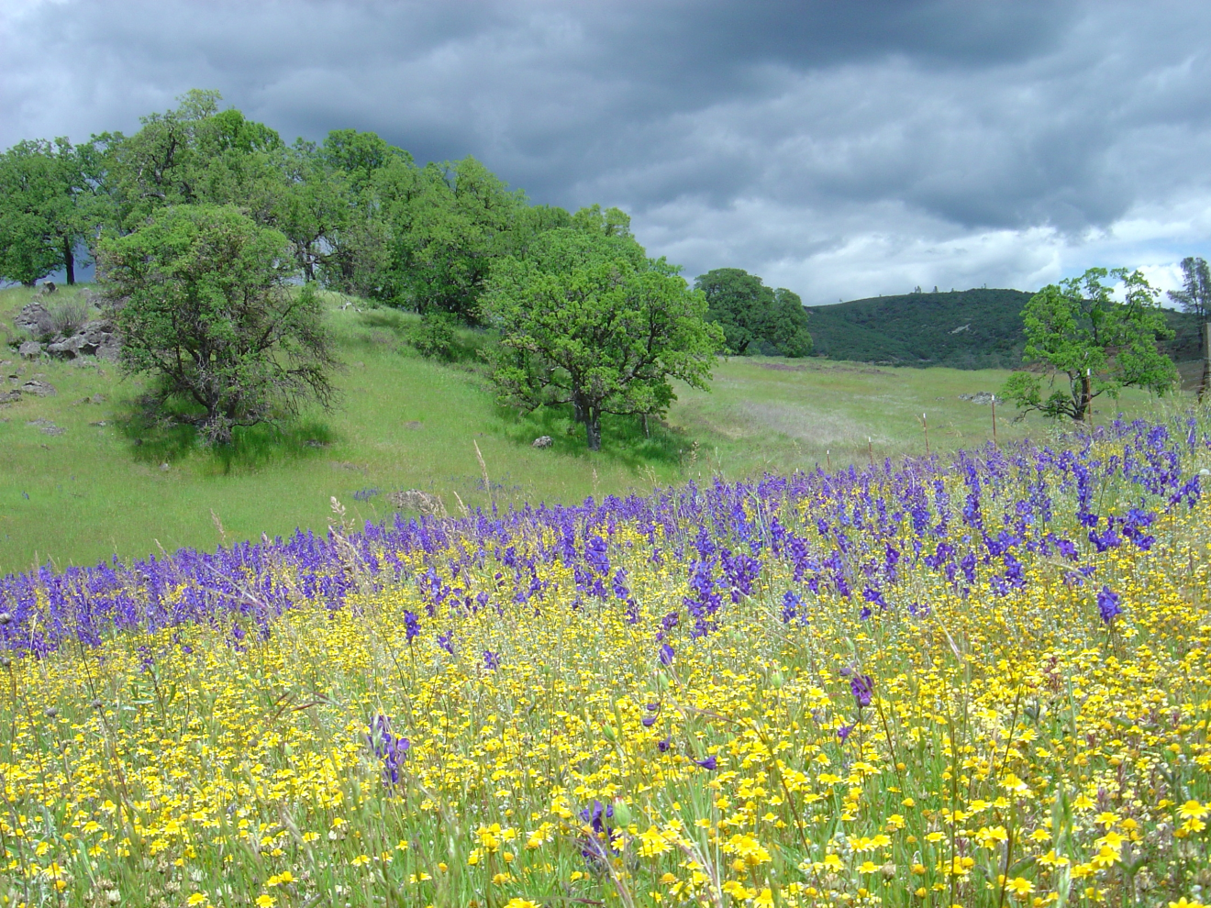
McLaughlin grasslands
Non-serpentine
Serpentine
Photo credit: J. Gelbard
Do serpentine and non-serpentine communities differ in temporal stability?
Notes:
What these patterns actually look like in the field is something like this: here we have a serpentine community in the foreground, covered by lupines and various asters, while the non-serpentine community in the background is covered by annual grasses. Based on our observed differences in the two communities, our initial question was: Do serpentine and non-serpentine communities differ in temporal stability?

Slide 6
10 year repeat survey
McLaughlin Reserve (Lake County, CA)
38 Serpentine, 42 Non-serpentine sites
5 m² quadrats along a 50m transect at each site
10 years presence/absence, 5 years cover
Photo credit: J. Gelbard
Notes:
We explored this question using a long-term dataset from McLaughlin reserve, located in the Coast Range of California. The for last 10 years our lab has been recording community composition from 80 grassland sites spread across the reserve. Roughly half of the sites are on serpentine soils and the other half are on non-serpentine. Each site consists of 5 meter squared quadrats placed 10 meters apart along a 50 m transect. The sites are sampled twice-annually to ensure both early and late season species are included. When the survey began in 2000, only presence of each species in the plot was recorded, but cover estimates were added starting in 2006.
From these data we calculated variation in richness and compositional turnover in time to climate, soil and community weighted mean functional traits.

Slide 7
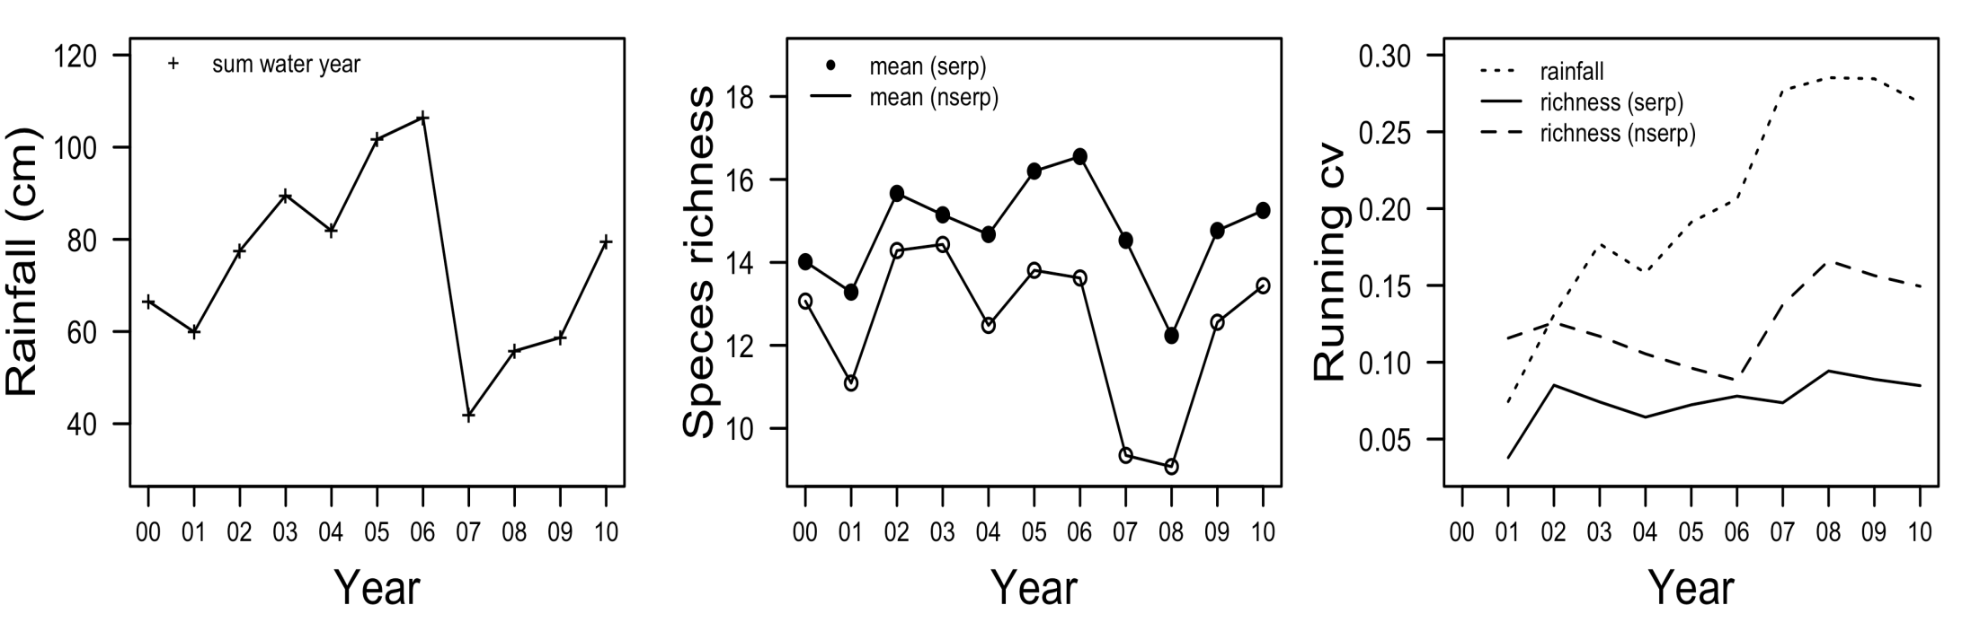
Species richness and rainfall
10 years captures climate variability
Species richness higher on serpentine
Species richness tracks precipitation, but correlation slightly weaker on serpentine (serpentine r² = 0.50, non-serpentine r² = 0.57)
Notes:
Before we compared stability in these grasslands, we needed to see how much climatic variation our ten year data set actually captured. This is a plot of precipitation over time and you can see in includes both very wet years and very dry years. If we were to plot a running mean we would see that the line is relatively flat, indicating that the data set does indeed do a good job of encompassing natural variation in rainfall.
Next, to compare the sensitivities of serpentine and non-serpentine grasslands to precipitation, we calculated the coefficient of variation over time for each soil type and correlated that CV to the temporal CV of precipitation. Just focusing on the middle figure, which is mean species richness for both grasslands over time, we see that serpentine grasslands (closed circles) are always more species rich than non-serpentine grasslands (open circles). When we plot the CV of species richness against rainfall, which is the third figure, we see two things: first the temporal CV of richness is always lower on serpentine (solid line). This is our first line of evidence that serpentine communities more stable than non-serpentine communities. We also see that while both communities track precipitation, the correlation between rainfall and variation in species richness appears to be weaker on serpentine. In fact the r2 for serpentine is lower than for non-serpentine.

Slide 8
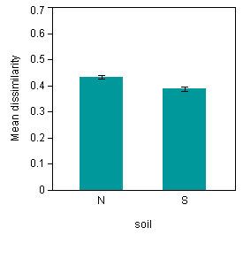
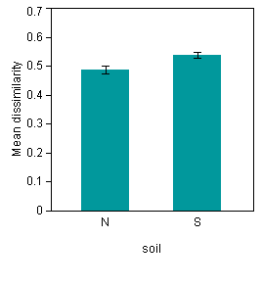
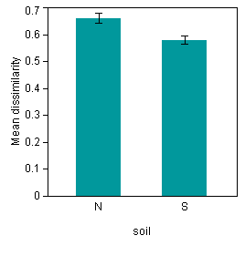
Temporal stability
*
*
*
Bray-Curtis w/annual grasses
Bray-Curtis
no annual grasses
Jaccard
Compositional turnover is lower on serpentine soils than non-serpentine soils, but is influenced by annual grasses
Notes:
While variation is species richness is one way to look at the stability of a community, it doesn’t present the whole picture because it doesn’t account for abundance of species. So, we also calculated turnover using different compositional metrics. For the entire 10 year data set we calculated temporal turnover using a frequency-based metric – Jaccard dissimilarity. High Jaccard values indicate high turnover. When using Jaccard we find that non-serpentine communities have higher temporal turnover than serpentine communities. However, when used a cover-based metric, in this case Bray-Curtis dissimilarity, we find the opposite pattern – serpentine grasslands are apparently less stable than non-serpentine grasslands.
This discrepancy between the 10 year and the 5 year data set perplexed a bit so we broke it down into different components. After looking at temporal variation in cover by different functional groups we found that annual grasses were the only functional group with a higher CV on serpentine than non-serpentine. For the sake of time, I’m not showing those data, but I can show you what happens to dissimilarity when you remove annual grasses from the cover data. It has a pretty dramatic effect – not only does dissimilarity increase in general, but now temporal turnover is lower on serpentine than non-serpentine, in agreement with our original metric.

Slide 9
Temporal stability
Serpentine grasslands are more resistant to variation in precipitation and more compositional stable than non-serpentine grasslands
Why?
Does soil explain stability?
Are serpentine communities more stress tolerant?
Photo credit: J. Gelbard
Notes:
So, from these data we can conclude that serpentine grasslands are less responsive to precipitation and are compositionally more stable over time than adjacent, non-serpentine grasslands. We also know that a relatively novel functional group, annual grasses, influences the stability patterns we see on the soils. I’ll come back to the weirdness that is annual grasses in a bit, but right now I want to focus on why serpentine communities appear to be more stable.
There are at least two different reasons why serpentine might be more stable: One possibility is that the soil itself somehow generates stability, perhaps by causing population dynamics to be very slow on resource-poor serpentine soils.
Alternatively, the stability might be generated by the species themselves, that is, serpentine communities may be composed of species that are relatively more stress tolerant.
These are not mutual exclusive hypotheses.

Slide 10
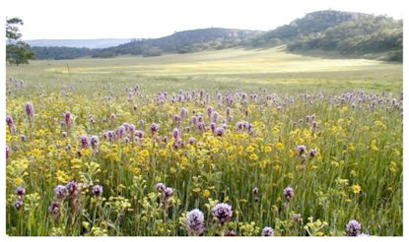
Soil and stability
Does soil explain stability?
Predictions
1. Compositional turnover should be postively related to a gradient of fertility
2. Soil generalists should be more stable on serpentine than on non-serpentine
Photo credit: S. Harrison
Notes:
Let’s focus on this first possibility – that the soil itself somehow determines stability. If that’s true, we can make two predictions – First, compositional turnover should be inversely related to a gradient of fertility. So, more turnover when the environment is less stressful. Second, if stability is a function of soil per se than soil generalists, species common on both serpentine and non-serpentine, should be more stable on serpentine.

Slide 11
Soil and stability
Predictions
Compositional turnover should be positively related to a gradient of fertility
Soil generalists should be more stable on serpentine than on non-serpentine
Approach
Principal component analysis of environmental variables (inc. N, P, K, Ca, and Mg)
Use first principal component axis as index of soil fertility
Correlate turnover with fertility gradient
Result
PC1 does not explain temporal turnover on serpentine or non-serpentine
Notes:
To test the first prediction – that compositional turnover should be inversely related to a gradient of fertility – we created an index of fertility using a principal component analysis of soil variables, including N, P, K, Ca, and Mg. I don’t have time to go in the details, but we found that the first axis was associated with a fertility gradient, so we used the first PC axis to predict stability in serpentine and non-serpentine grasslands.
We found that environmental variables actually do a very poor job of predicting stability for either community. This is strike one against soil itself generating stability.

Slide 12
Soil and stability
Predictions
1. Compositional turnover should be inversely related to a gradient of fertility
2. Soil generalists should be more stable on serpentine than on non-serpentine
Approach
Compare the temporal coefficient of variation in cover for species common on serpentine and non-serpentine (n=41, includes all functional groups)
T-test with species as replicates
Result
Temporal variation does not differ by soil type for soil generalists
Notes:
To test our second prediction, that soil generalists should be more stable on serpentine than non-serpentine, we compared the temporal coefficient of variation in cover for species common on both soil types. Our criteria was that they occur in at least 10 serpentine and 10 non-serpentine sites, which gave a list of 41 species that sampled from all 4 functional groups.
We then used a t-test, with species as replicates, to determine if the CV of cover differed by soil type.
And, the answer is a big fat No, temporal variation does not differ by soil for generalist species. Strike 2 against soil. At this point, based on our available data – we conclude that stability does not arise as a function of soil. What about our alternative hypothesis?

Slide 13
Functional traits and stability
Are serpentine communities more stress tolerant than non-serpentine communities?
Predictions
1. Serpentine communities should be shorter and have lower specific leaf area, leaf water content, leaf area, and percent foliar nitrogen
2. Stability should positively correlated to a gradient of stress tolerance
Photo credit: B. Going
Notes:
That the stability of serpentine communities may arise from the traits of species themselves. If this is true than we can make 2 predictions. First, serpentine communities should be more stress tolerant than non-serpentine communities. Thus we predict that community-weighted mean traits should show that serpentine communities are shorter, with lower specific leaf area, leaf water content, leaf area, and percent foliar nitrogen because these trait patterns are associated with tolerance to low resource environments and to resource acquisition.
Second, we predicted that temporal turnover should be positively correlated with a index of stress tolerance.

Slide 14
Functional traits and stability
Predictions
1. Serpentine communities should be shorter and have lower specific leaf area, leaf water content, leaf area, and percent foliar nitrogen
2. Stability should positively correlated to a gradient of stress tolerance
Approach
T-tests for differences in community-weighted mean functional traits (inc SLA, LWC, Leaf area, Height, and Foliar N) between soil type
Result
Serpentine grasslands are slightly shorter and have smaller SLA and Leaf area, but have more Foliar N
Notes:
Focusing on the first prediction, we expect that serpentine communities will be more stress tolerant than non-serpentine communities. To test this prediction we used a trait data set compiled by our lab last summer. We collected trait data from 191 species found in the long-term data set. While not all species, it represents 75% of the 260 some species. For each of these species we measured height, specific leaf area, leaf area, leaf water content, and percent foliar nitrogen. For soil generalists we measured traits for plant occurring on both soils. To determine traits of the community as a whole we calculated community-weighted mean trait values using a package in R. The function simply weighted a species trait by its relative abundance in the plot, then sums those values for a single value per plot. We then used a t-test to determine if the communities differed in traits.
Supporting our prediction we found than serpentine communities tended to be shorter (although this difference was only marginally significant), and have lower leaf area and specific leaf area. Contrary to our expectations, percent foliar nitrogen was higher in serpentine communities than non-serpentine communities. Overall, these results lend some support to the hypothesis that species functional traits lead to differences in stability, but we now we need to know if these traits can predict stability.

Slide 15
Functional traits and stability
Predictions
1. Serpentine communities should be shorter and have lower specific leaf area, leaf water content, leaf area, and percent foliar nitrogen
2. Stability should be positively correlated to a gradient of stress tolerance
Approach
Principal component analysis of community traits
Use first axis as index of “stress-tolerance”
Correlate index with turnover
Notes:
That is, if stability is a function of species traits, then temporal turnover should be inversely related with a gradient of stress tolerance. To test this prediction we first ran a principal component analysis of community traits and found that we could use the first axis as an index of stress tolerance. Similar to our approach with the environmental data we attempted to correlate stability in serpentine and non-serpentine grasslands with this index.

Slide 16
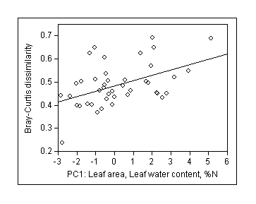
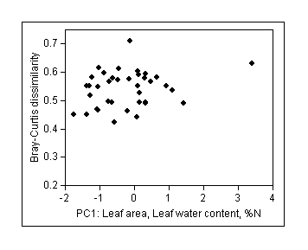
Functional traits and stability
Result with annual grasses
PC1 (46% variation; Leaf area, LWC, and %N) is positively correlated with turnover on non-serpentine
PC1 does not explain stability on serpentine
Non-serpentine r² = 0.22
Serpentine r² = 0.06
Notes:
The first PC axes explained 46% of the variation in trait space and was associated with increasing leaf area, leaf water content, and % foliar nitrogen. We interpreted this as an index of decreasing stress tolerance and it found it was positively correlated with turnover in non-serpentine grasslands. There was no relationship between this axis and serpentine turnover.
Recalling that annual grasses had such a large influence on turnover, we wanted to see if they also influenced community traits and the relationship between traits and stability. So we reran our analysis after excluding them.

Slide 17
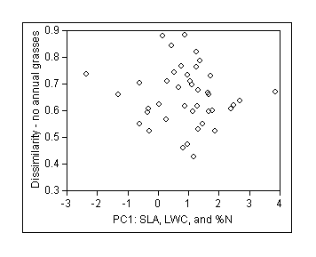
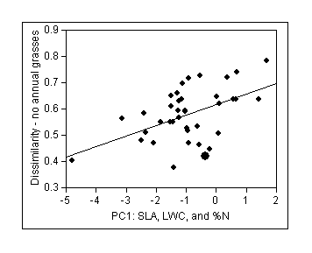
Functional traits and stability
Result without annual grasses
PC1 (44% variation; SLA, LWC, and %N) is positively correlated with turnover on serpentine
Annual grasses influence relationship between traits and turnover
Non-serpentine r² = 0.03
Serpentine r² = 0.25
Notes:
After excluding annual grasses we get a similar association with traits and the first principal component axis, except instead of being associated with leaf area, PC1 is now associated with increasing specific leaf area. LWC and %N remain the same. Again, we were able to interpret this axis as a gradient of decreasing stress tolerance. PC1 was unrelated to turnover on non-serpentine, but was positively correlated with turnover on serpentine.
Summarizing the last two slides basically suggests the stress tolerance does increase community stability over time, but stability is also influenced by a major and somewhat novel functional group. Annual grasses actually increase stability in non-serpentine communities, but decrease stability in serpentine grasslands. So, what the heck is up with annual grasses? What’s different about them?

Slide 18
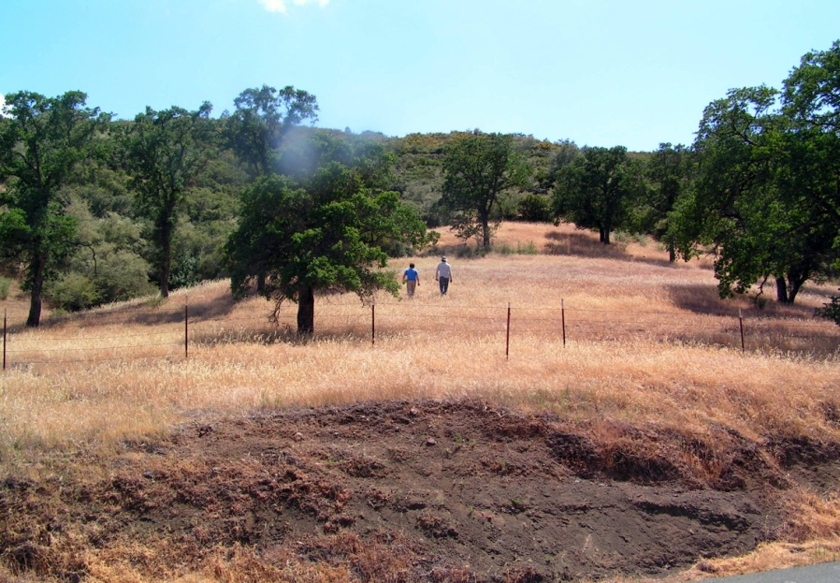
Annual grasses: traits and stability
Why do annual grasses influence stability?
Novel functional group (14/17 species at McLaughlin are exotic)
The only functional group with HIGHER variation on serpentine
Annual grass traits suggest less “stress-tolerator” and more “good competitor” (fast growth)
Higher specific leaf area
Lower %N
Photo credit: B. Going
Notes:
First, as I’ve mentioned already, they’re a novel functional group in California grasslands. Of the 17 annual grasses found at McLaughlin reserve only 3 are actually native, so the lion’s share are exotic. Looking at their traits may provide further insights. Annual grasses tend to have higher specific leaf areas than other functional group and their percent foliar nitrogen is lower than most other functional groups. Some of the literature out there suggests that rather than indicating tolerance to low nitrogen availability, low concentrations of foliar nitrogen may indicate faster growth rates, which causes a dilution of tissue N. If true, then these traits suggest that annual grasses may be using a competitive strategy, rather than a stress tolerant strategy. This may not always work out for them, especially on serpentine where abiotic stress may interact with climatic stress. This is consistent with previous results from other serpentine grasslands. Hobbs et al found that some annual grasses became abundant on serpentine following climatically favorable years, but nearly disappeared during dry periods.

Slide 19
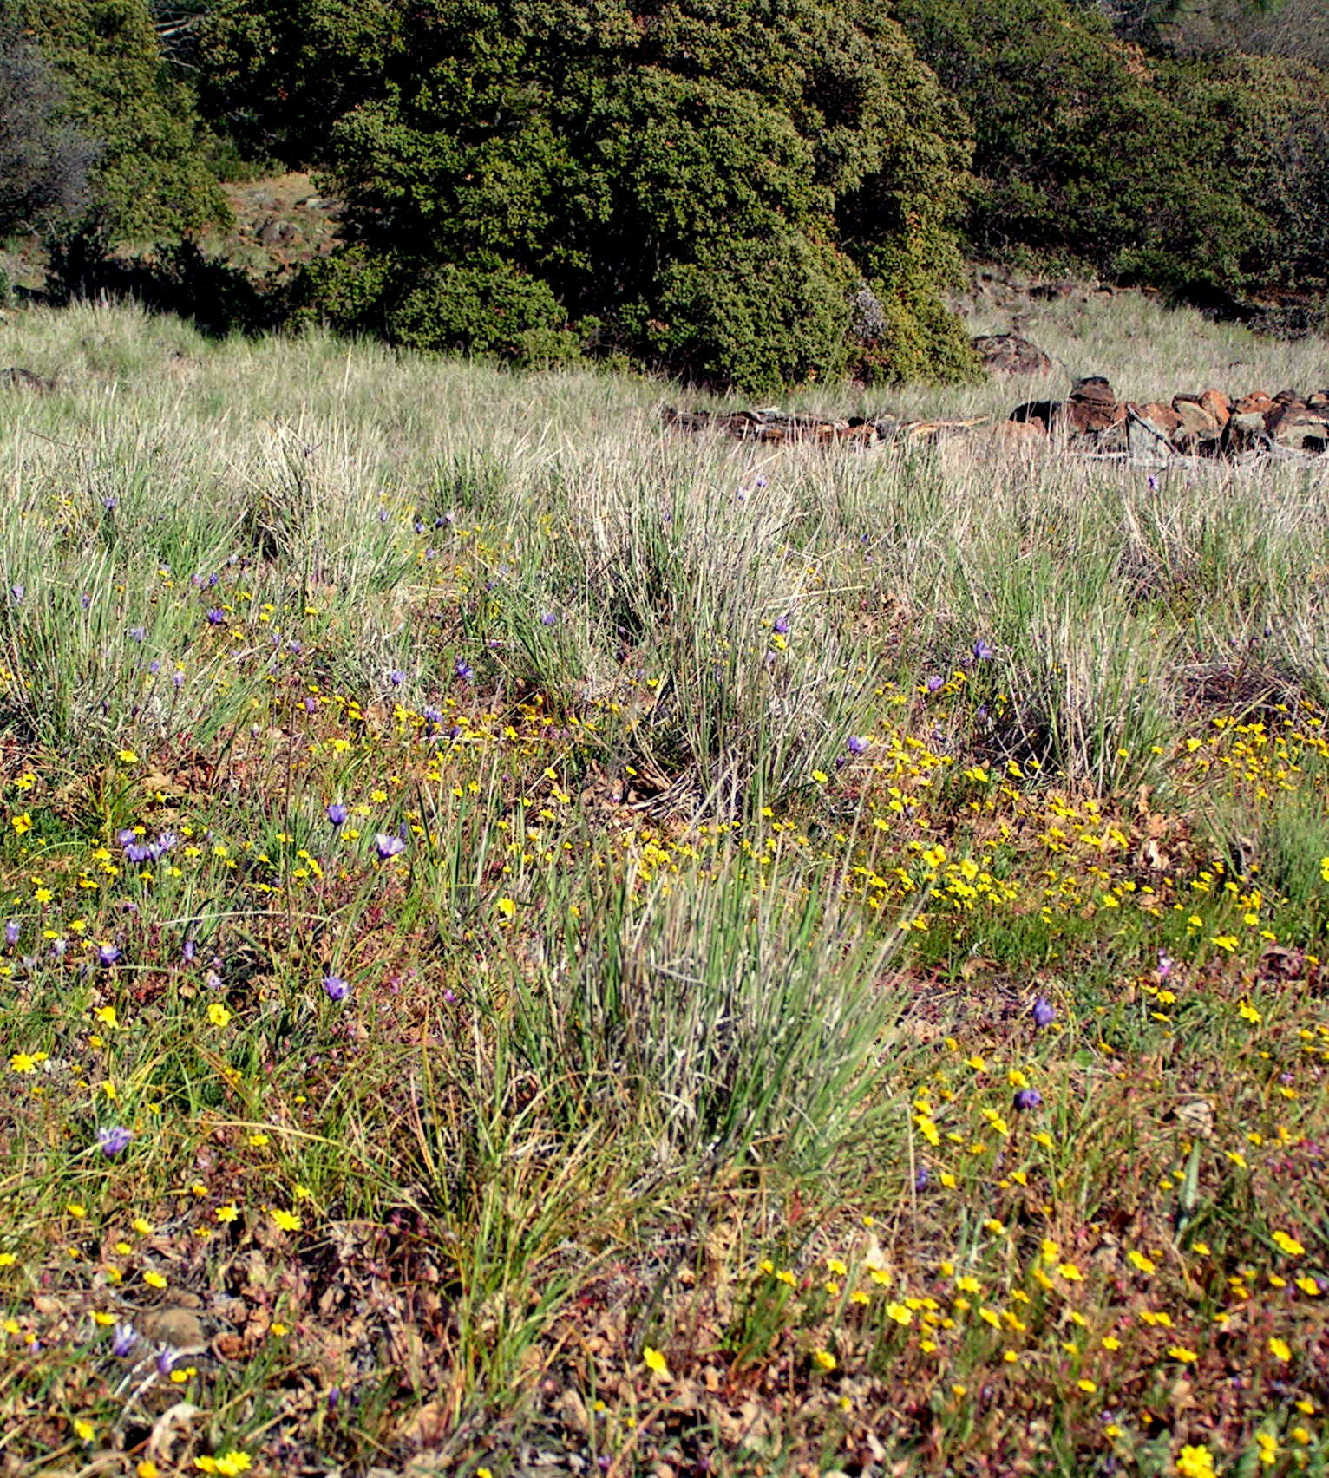
Conclusions
Serpentine communities are more stable than communities on more fertile soils
Species functional traits, rather than soil, partly explain stability, but depend on the functional group
Functional traits suggest serpentine communities are more stress tolerant
May confer resistance to climate change to serpentine and other unproductive habitats
Photo credit: B. Going
Photo credit: B. Going
Notes:
In conclusion – we found that species-rich serpentine communities were less responsive to precipitation and were compositionally more stable over time than communities on more fertile, non-serpentine soils. Stability in these grasslands is function of species functional traits, rather than soil itself. However, functional groups may differ in traits in ways that influence stability. We found that a highly dynamic, relatively novel functional group (annual grasses) influenced stability in opposing ways in serpentine and non-serpentine grasslands. These species, more than any other functional group, show traits associated with a competitive strategy that may not always payoff.
We also found that serpentine communities showed traits associated with stress tolerance, which seems to confer some resistance to variation in precipitation, giving us hope that these communities, and perhaps other special soil communities, may be relatively resistant to climate change.
I do want to add that functional traits could explain only some of the variation in stability and there other factors are likely to play a role. Coming back to the role of soil, one intriguing possibility for stability is microsite heterogeneity. Recently Jason Fridley and Grime explored the those limestone plots in the UK and found that fine-scale soil heterogeneity seem to buffer the community against environmental change. I think this could be important for serpentine as well.

Slide 20
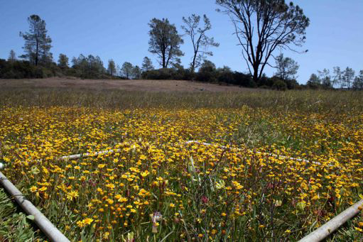
Acknowledgments
Data collection
Kara Moore O’Leary
Sarah Elmendorf
Erica Case
Stella Copeland
Annette Bieger
Jill Baty
Peter March
Andy Kleinhesselink
Photo credit: B. Anacker
Funding
NSF LTREB

Slide 21
Community traits
Trait | Correlation | Pattern
Height | Competitive ability, fecundity | Taller plants in productive habitats
Specific leaf area (SLA) | Potential growth rate, photosynthesis, leaf longevity | Low SLA in low resource habitats
Leaf area | Leaf energy, water balance | Small leaves in low resource habitats
Leaf water content (LWC) | Water balance | Low LWC in arid habitats
C:N | Carbon: leaf longevity Nitrogen: photosynthesis | High C:N in low resource habitats
Notes:
To test this hypothesis we measured 7 different traits associated with stress-tolerance for 191 (or 75% of all species in our plots) species found in our plots: height, specific leaf area, leaf area, leaf water content, carbon, nitrogen, and C:N. We selected these traits because previous work has suggested they represent a suite of physiological mechanisms linked to stress tolerance or competitive ability. Based on the literature we expected stress-tolerant communities to be composed of shorter species with smaller, thicker leaves than communities with species using a more competitive strategy. In addition, we expected stressful habitats to have species with more carbon and a higher C:N than species from more benign habitats. For each site we calculated the community weighted mean value for each trait, which simply weights a species trait by it’s abundance, then sums the values for a single value per plot. Whenever a species occurred on serpentine and non-serpentine we collected plants from each soil type for trait measurements.

